Slide 1
Linux Command Execution Time Profiler
OPERATING SYSTEMS HACKATHON PROJECT
TEAM MEMBERS
ROLL NO. | NAME
2520030432 | K ANUSRI
2520030440 | K SAI ANSHU
2520030193 | K DHEERAJ
2520030028 | B MOHITH
A Linux-Based Tool for Measuring Command Execution Time and Resource Usage
Department of Computer Science and Engineering
KLH Bachupally / KL University
Faculty: V MUNIRAJU
Notes:
Introduce the project and the team. Say: this is our Operating Systems hackathon project, the Linux Command Execution Time Profiler. It is a small C program that runs a Linux command and reports how long it took and what resources it used. (Note: the program banner and README use the shorter name 'Linux Command Execution Profiler'; both refer to the same program.) Faculty guide: V MUNIRAJU.

Slide 2
Problem Statement
Users run commands for file management, system operations and other tasks.
1
PROBLEM STATEMENT
Develop a Linux-based tool that executes commands and reports their elapsed execution time, CPU usage, maximum memory usage, and exit status.
They may want to know how long a command takes to complete.
2
Execution time alone does not give the full picture of resource usage.
3
Elapsed time
CPU usage
A simple command-line profiler can collect time and process-resource data in one place.
Maximum memory
Exit status
4
Notes:
Explain the motivation. We use commands like ls all the time but rarely know how long they take or how much CPU/memory they use. Elapsed time alone is not enough: a command can take 2 seconds but use almost no CPU (we will see this with sleep 2). Our problem statement is on the right: build a Linux tool that runs a command and reports elapsed time, CPU usage, maximum memory and exit status.

Slide 3
Project Objectives and Solution
Objectives
Proposed solution
1
Measure command execution time.
Terminal
$ ls -l
2
Collect user CPU time and system CPU time.
Report maximum resident set size.
Profiler (C program)
fork() > execvp() > wait4()
3
4
Display command exit status.
Execution report
time, CPU, memory, exit status
5
Handle invalid commands and empty input.
Run multiple commands in one profiler session.
A C program creates a child process, runs the command, waits for it, collects timing and resource data, then prints a report.
6
Notes:
Read the six objectives quickly, then explain the solution. Our solution is one C program. It reads a command, creates a child process, runs the command in the child, waits for it to finish, collects timing and resource data, and prints an execution report. The diagram on the right shows terminal -> profiler -> report.

Slide 4
Technologies and Tools
Tools
Important APIs
C
Program implementation
GCC
Compilation
fork()
Creates a child process.
execvp()
Executes the requested program.
Linux / Ubuntu
Execution environment
Git
Version control
wait4()
Waits for the child process and collects resource-usage information.
WSL2
Linux environment on Windows
GitHub
Source-code hosting
clock_gettime(CLOCK_MONOTONIC)
Measures elapsed wall-clock time.
Notes:
Left: the tools we used. C for the program, GCC to compile, Ubuntu on WSL2 as the Linux environment on Windows, Git and GitHub for version control and hosting. Right: the four key APIs. fork() creates the child, execvp() runs the command, wait4() waits and gives us resource usage, and clock_gettime with CLOCK_MONOTONIC measures elapsed wall-clock time.

Slide 5
System Architecture
1
Enter command
2
Parse input
3
Create child
Read one line with fgets()
strtok() splits at spaces/tabs into command + arguments
Start time recorded, then fork()
PARENT
CHILD
6
Compute elapsed time
5
Parent waits
4
Run command
CLOCK_MONOTONIC end time minus start time
wait4() returns status and resource usage
execvp() in child; on failure perror() and exit 127
7
Collect results
8
Display report
9
Next command or exit
CPU times and max memory from rusage; exit status
Print the execution report
Back to step 1; typing exit ends the session
Notes:
Walk through the flow in order. 1: user enters a command. 2: the program splits it at spaces. 3: it records the start time and calls fork(), which creates a child process. 4: the child calls execvp() to run the command; if the command does not exist, execvp fails, the child prints an error and exits with status 127. 5: meanwhile the parent calls wait4(), which waits for the child and fills in the resource-usage structure. 6: the end time is taken and elapsed time is computed. 7: user CPU, system CPU and max memory come from the rusage structure; the exit status comes from the wait status. 8: the report is printed. 9: the loop returns to the prompt until the user types exit. Note: the dark boxes are the three key process-management steps. The input checks (empty line, too-long line, exit) happen in step 1 before any process is created.

Slide 6
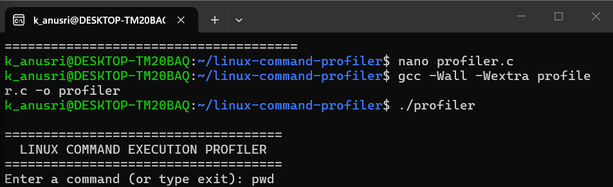
Implementation Approach
1
Accept command input
fgets() + validation + strtok()
2
Create a child process
fork()
3
Execute the command
execvp() in the child
Actual terminal: compile and start the profiler
REPORT FIELDS
4
Measure elapsed time
clock_gettime(CLOCK_MONOTONIC)
Command
Execution time
User CPU time
Collect CPU and memory usage
wait4() fills struct rusage
System CPU time
Maximum memory
Exit status
5
Compile gcc -Wall -Wextra profiler.c -o profiler
6
Display the execution report
printf() report + exit status
Run ./profiler
Notes:
Six stages: accept input, create child, execute command, measure elapsed time, collect CPU and memory usage, display the report. The report has six fields: command, execution time, user CPU time, system CPU time, maximum memory and exit status. Compile with gcc -Wall -Wextra profiler.c -o profiler and run with ./profiler. The screenshot is our real compile-and-start session. Point out: the 'Command' field shows only the command name (for example 'ls' for 'ls -l'), because the program prints the first token. User and system CPU time come from the rusage structure filled by wait4(); maximum memory is the maximum resident set size in KB.

Slide 7
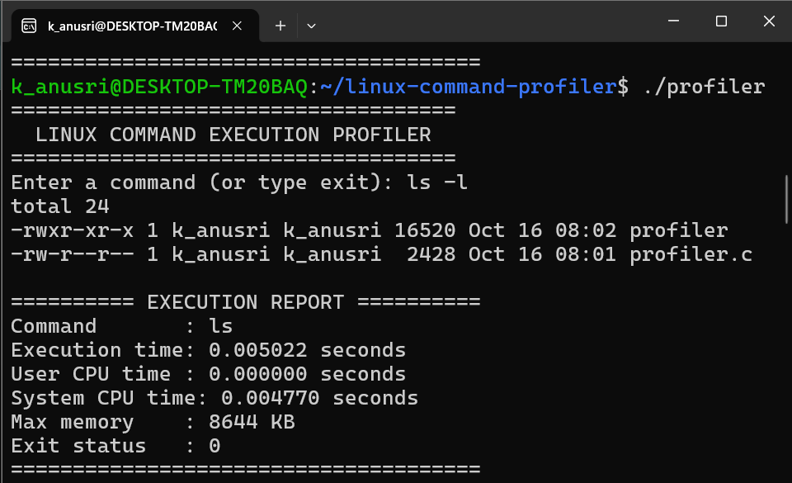
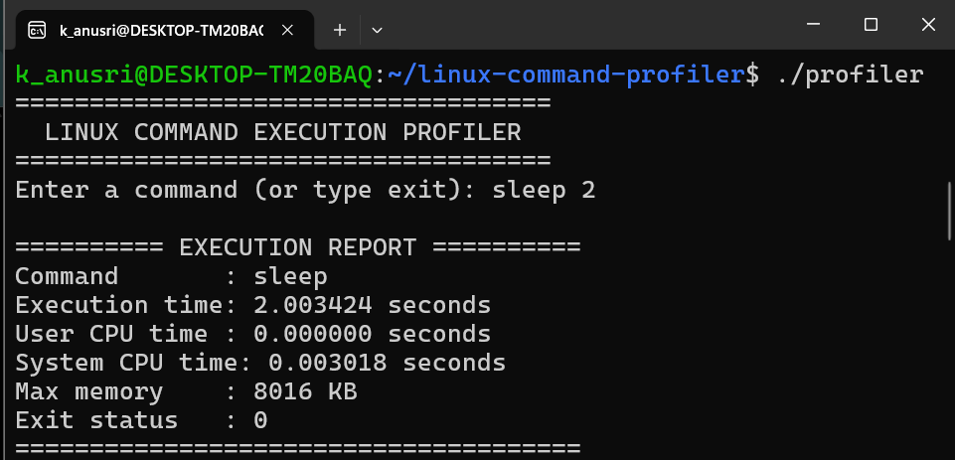
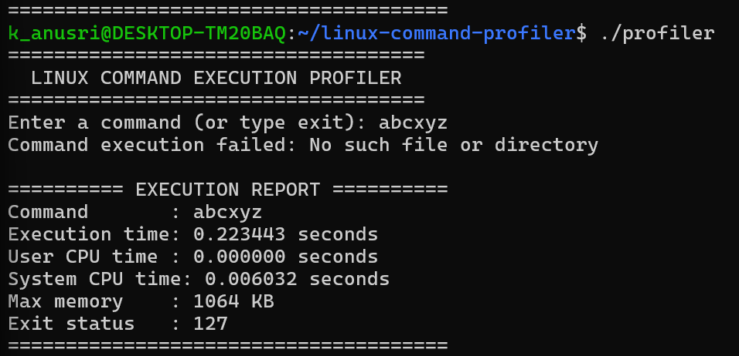
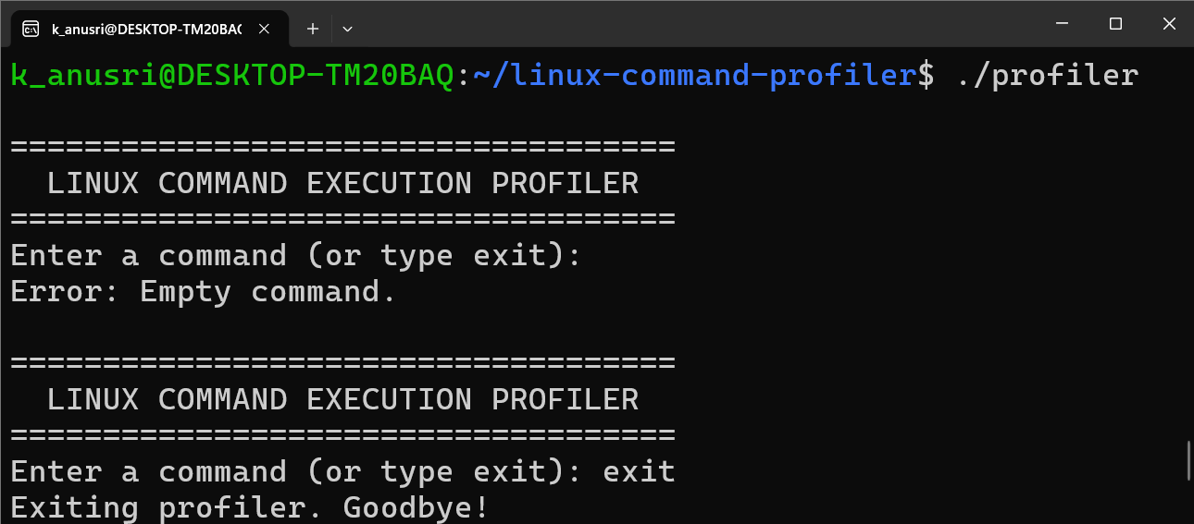
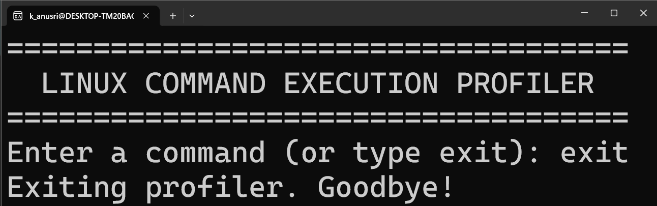
Testing the Profiler
# | Input | Purpose | Result | Basis
1 | ls -l | Verify successful command execution | Observed exit status: 0 | Observed (screenshot)
2 | sleep 2 | Validate elapsed-time measurement | Elapsed time: 2.003424 s; exit status: 0 | Observed (screenshot)
3 | abcxyz | Test invalid-command handling | Error: “Command execution failed: No such file or directory”; exit status: 127 | Observed (screenshot)
4 | (empty input) | Verify input validation | Expected: “Error: Empty command.” and the prompt returns | Expected (README / source)
5 | exit | Verify program termination | Expected: “Exiting profiler. Goodbye!” and the program ends | Expected (README / source)
Observed: value or message visible in the terminal screenshots
Expected: behaviour from the source code; recorded as passed in the README, no screenshot
Notes:
Be clear about what is measured and what is expected. Tests 1 to 3 are observed: we have terminal screenshots with the values. Tests 4 and 5 (empty input and exit) are expected behaviour taken from the source code and recorded as passed in our README, but we did not capture screenshots, so we label them 'Expected'. Test 1 observed exit status 0; Test 2 elapsed 2.003424 s; Test 3 printed 'Command execution failed: No such file or directory' and exit status 127 (the usual shell convention for 'command not found').

Slide 8
Results and Observations
TEST A | ls -l
TEST B | sleep 2
TEST C | abcxyz
Execution time | 0.005022 s
User CPU time | 0.000000 s
System CPU time | 0.004770 s
Maximum memory | 8644 KB
Exit status | 0
Execution time | 2.003424 s
User CPU time | 0.000000 s
System CPU time | 0.003018 s
Maximum memory | 8016 KB
Exit status | 0
Execution time | 0.223443 s
User CPU time | 0.000000 s
System CPU time | 0.006032 s
Maximum memory | 1064 KB
Exit status | 127
OBSERVATIONS
Successful commands return exit status 0 in these tests.
An invalid command produces an error and exit status 127.
The sleep 2 test completes in about two seconds of elapsed time.
Measurements can vary between executions and system conditions.
Notes:
These are the real measurements from our terminal screenshots, unaltered. Test A, ls -l: 0.005022 s elapsed, 8644 KB, exit 0. Test B, sleep 2: 2.003424 s elapsed but only 0.003018 s system CPU and zero user CPU: the process mostly waits, so elapsed time and CPU time are very different. Test C, abcxyz: the command does not exist, so execvp fails in the child, which exits with 127. Its elapsed time (0.223443 s) is larger than ls -l; we ran each test once and did not investigate why, so we do not draw conclusions from it. Elapsed time includes the cost of fork() and execvp(), since the start time is taken before fork(). Every value is from a single run and may vary; these are example outputs, not benchmarks. The Command field shows 'ls' for 'ls -l' because only the first token is printed.

Slide 9
Limitations and Future Scope
Current limitations
Future enhancements
PROPOSED - NOT BUILT
Accepts simple space-separated commands and arguments.
Does not implement full shell parsing.
Does not support shell pipelines or input/output redirection.
Measurements may vary between runs.
The current version is a command-line tool.
Support more advanced command parsing.
Add support for pipelines and redirection.
Save execution reports to files.
Compare repeated command executions.
Provide report summaries or graphical performance visualizations.
Notes:
Left side: what the current version cannot do. It only splits at spaces and tabs, so there are no pipes, redirection or quoted arguments with spaces. Results vary run to run, and it is a command-line tool only. Right side (dashed border): these are PROPOSED future improvements, not features that exist today: better parsing, pipelines and redirection, saving reports to files, comparing repeated runs, and summaries or graphs. Additional limitations from the report if asked: shell built-ins like cd are not available because commands run through execvp(); lines over 255 characters are rejected; at most 63 tokens are kept.

Slide 10
Conclusion and Impact
Developed a C-based Linux Command Execution Time Profiler.
Measured elapsed execution time, CPU usage, maximum memory usage, and exit status.
Tested successful commands, timed execution using "sleep 2", and invalid-command handling.
Demonstrated Linux process-management concepts using "fork()", "execvp()", and "wait4()".
Helps users understand command execution time and associated resource usage in one report.
Provides a foundation for future command-performance analysis and optimization.
GITHUB REPOSITORY
https://github.com/
kanusri-tmj/
linux-command-profiler
Thank You
Notes:
Summarise: we built a C-based profiler that runs a command with fork, execvp and wait4, measures elapsed time with CLOCK_MONOTONIC, and reports CPU time, maximum memory and exit status. We tested a normal command, a sleep command and an invalid command. It demonstrates process creation, execution and waiting, and gives a foundation for further analysis. Source code and README are in the GitHub repository. Invite questions.

